Slide 1

#7 @ Data Journalism with R intro + slack + Book Club + R4DS-es
library(dplyr)
rladies_global %>%
filter(city == ’Munich')

Slide 2
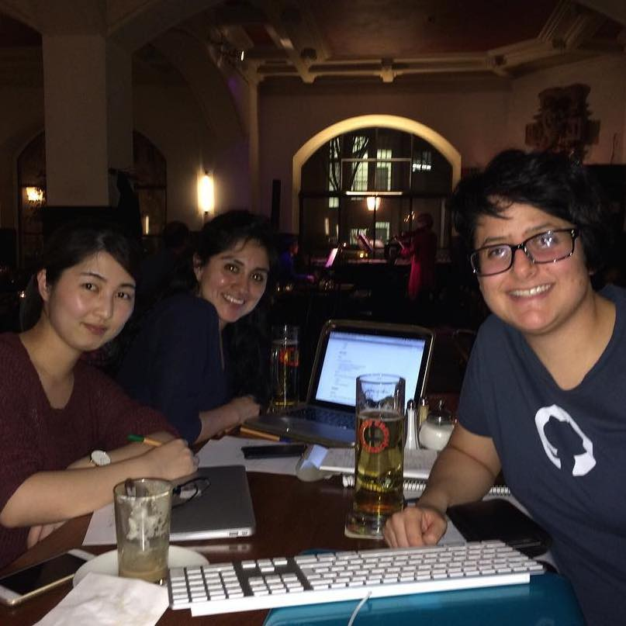
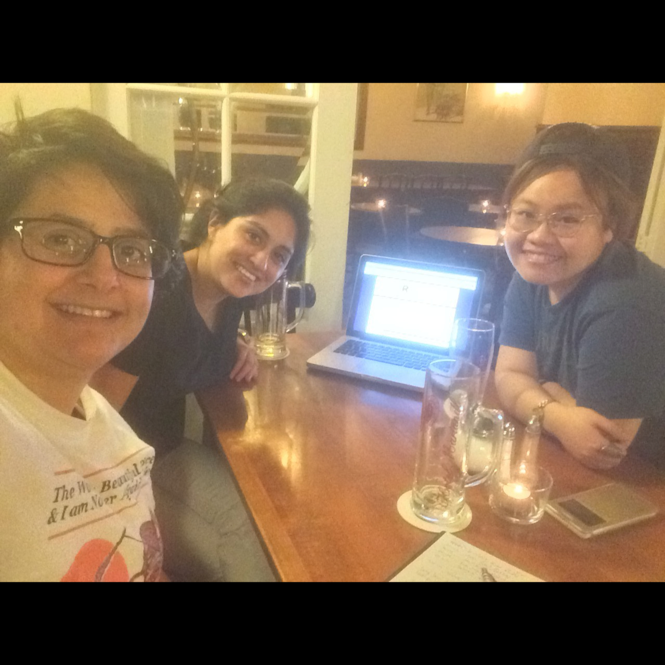
Servus!
🍻
We’re R-Ladies Munich!
We’re part of a R-Ladies Global, a worldwide organization to promote gender diversity in the R statistical computing community.

Slide 3
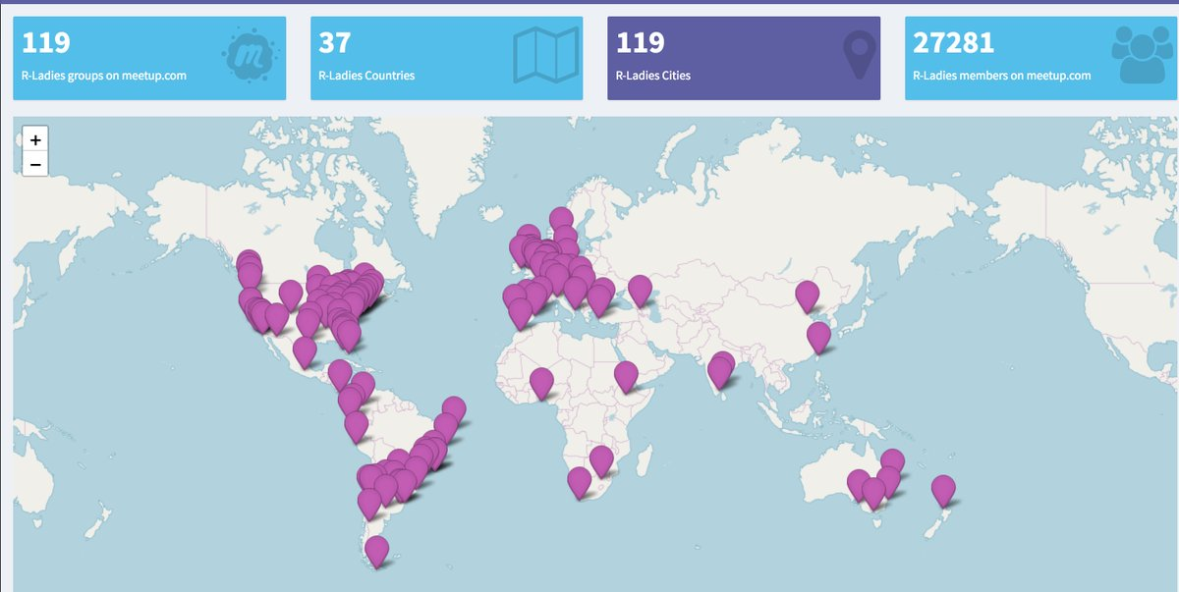
R-Ladies Global:
Today there are 119 chapters and over 27k members around the world.

Slide 4
But how did we get there?
Gabriela de Queiroz, Data Scientist
San Francisco, Oct 2012
770 members, 30+ past meetups
London, Jan 2016
694 members, 15 past meetups
47 chapters as of Apr 2017 (including Paris, Melbourne, Istanbul, Tbilisi, Barcelona, Buenos Aires, Taipei, Berlin, and across the US)
Set of slides courtesy of R-Ladies Dublin

Slide 5
14%
30%
41%
R package developers are women
Female participants at useR! 2016
Scientific/Analytical Occupations (American Community Survey 2014)
Data provided by R Women Taskforce http://rpubs.com/hturner/useR2016
Set of slides courtesy of R-Ladies Dublin

Slide 6
Mission
To improve the participation and experience of women in the R community.
To achieve a proportionate gender representation in the R community
To support R enthusiasts who identify as female to help them achieve their programming potential by building a collaborative network of R leaders, mentors, learners and developers to facilitate individual and collective progress worldwide.
Set of slides courtesy of R-Ladies Dublin

Slide 7
Code of Conduct
R-Ladies is dedicated to providing a harassment-free experience for everyone. We do not tolerate harassment of participants in any form.
This code of conduct applies to all R-Ladies spaces, both offline and online, including: meetups, Twitter, Slack, mailing lists. Anyone who violates this code of conduct may be sanctioned or expelled from these spaces at the discretion of the Founding Members (…)
If you are being harassed by a member/guest/participant of/at R-Ladies, notice that someone else is being harassed, or have any concerns, please contact the Founding Members via reporting@rladies.org
Set of slides courtesy of R-Ladies Dublin

Slide 8
2.
R-Ladies Munich
When | Who | Why

Slide 9
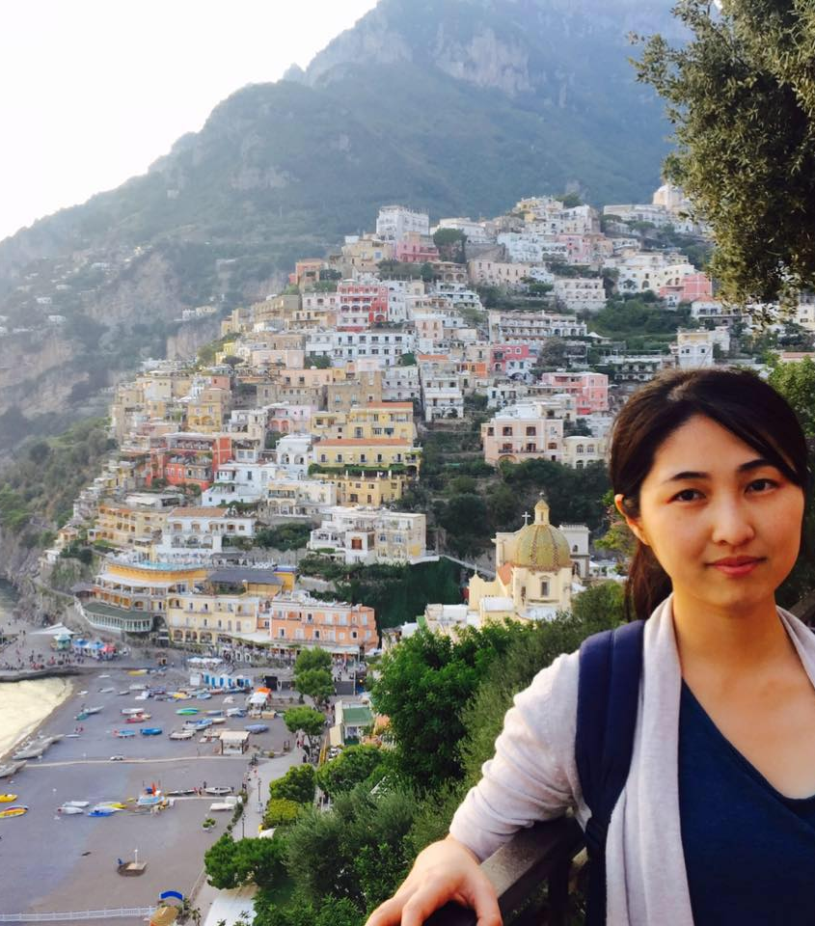
Dan Huang
Originally from China
Studied Epidemiology at the LMU

Slide 10
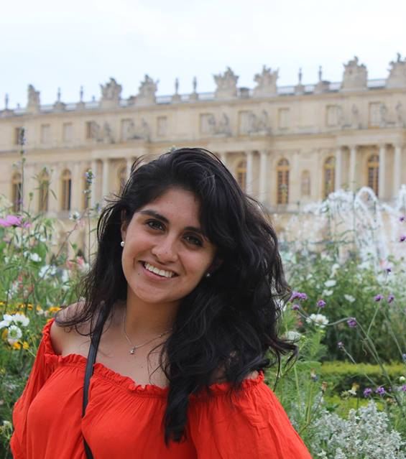
Pamela Matías
Originally from Mexico
PhD candidate from the Experimental Medicine program at TUM and the Helmholtz Center

Slide 11
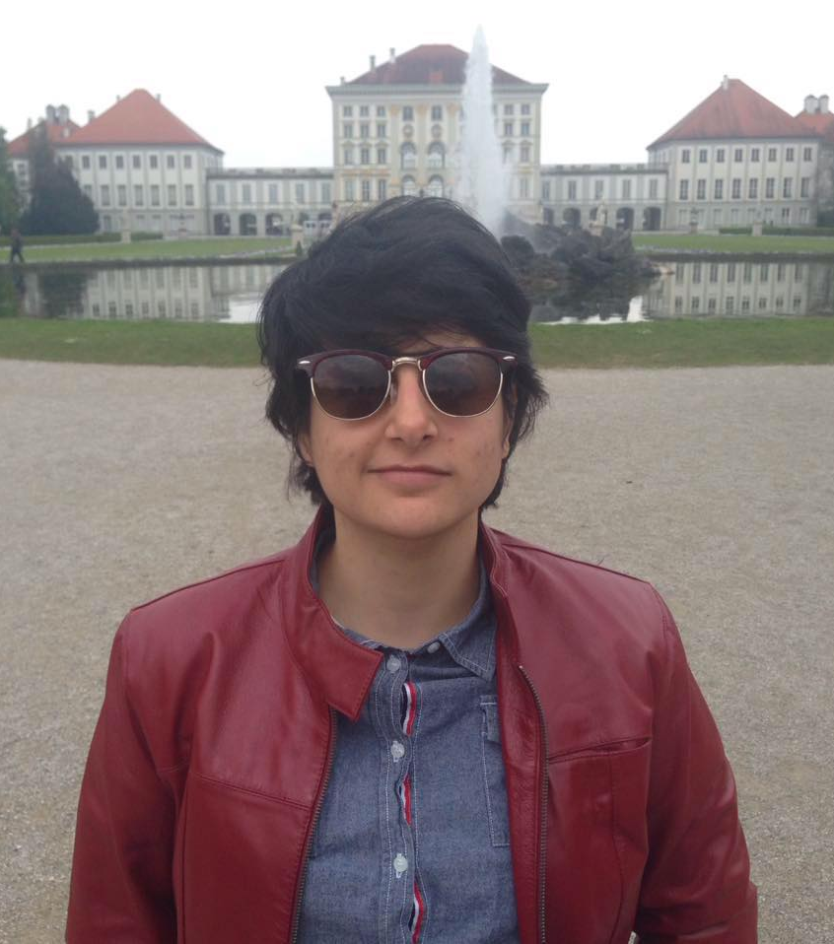
Daloha Rodríguez Molina
Originally from Venezuela.
PhD candidate in the Epidemiology program at the LMU

Slide 12
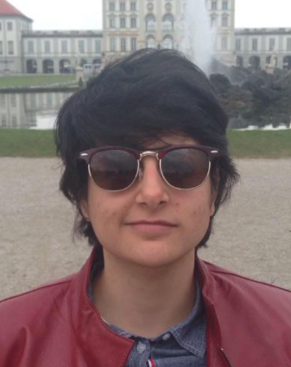
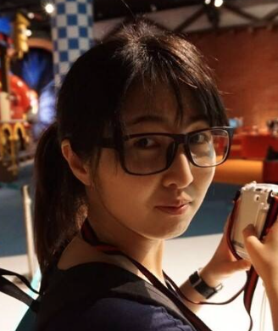
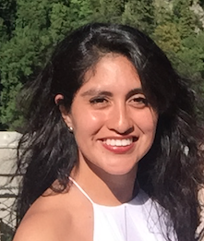
We’re Daloha, Dan, & Pam
And we’re so hyped about everyone in this room is making
RLadies Munich happen!
Join us in Meetup, Instagram, Twitter, Facebook and Slack

Slide 13

is back!

Slide 14
is back!
(now for real)

Slide 15


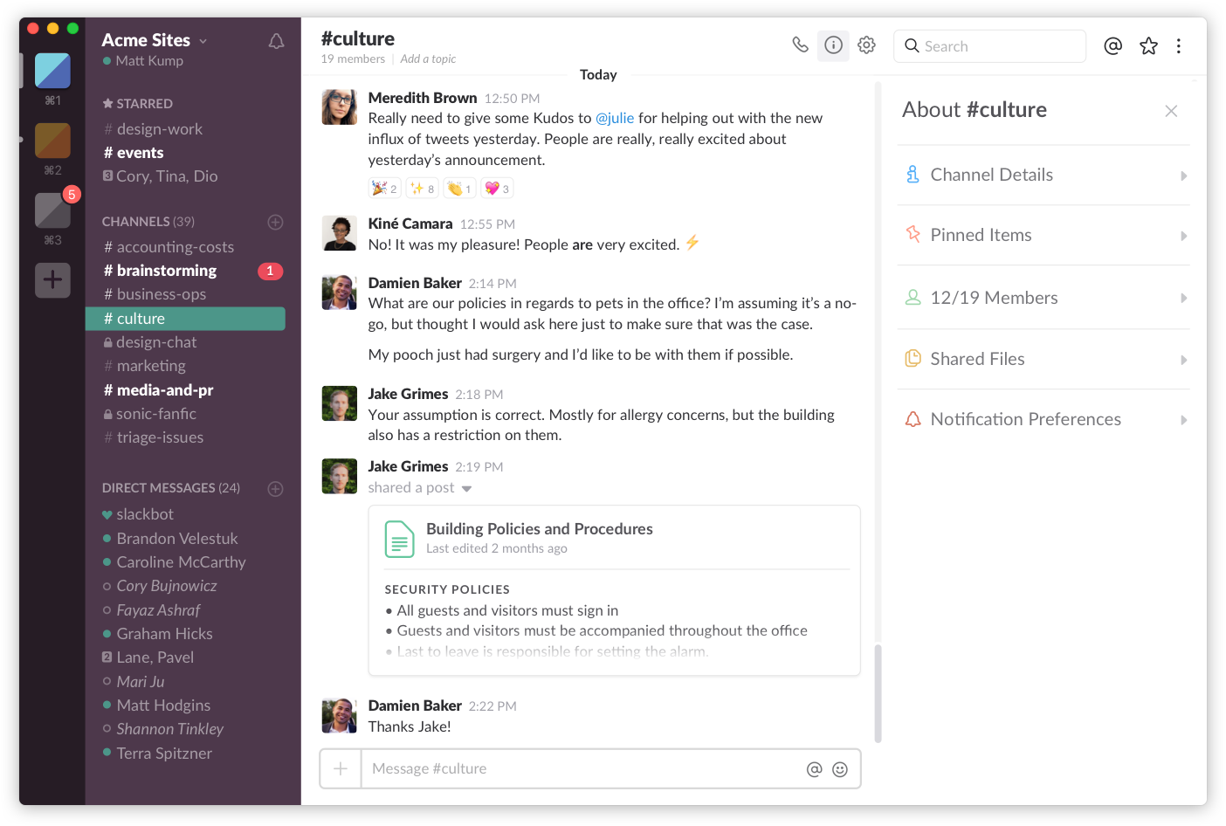
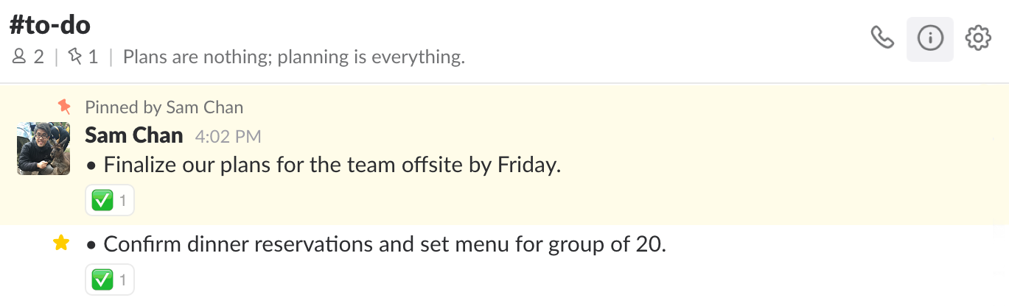
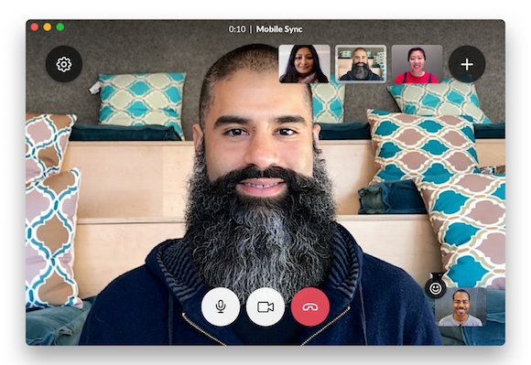
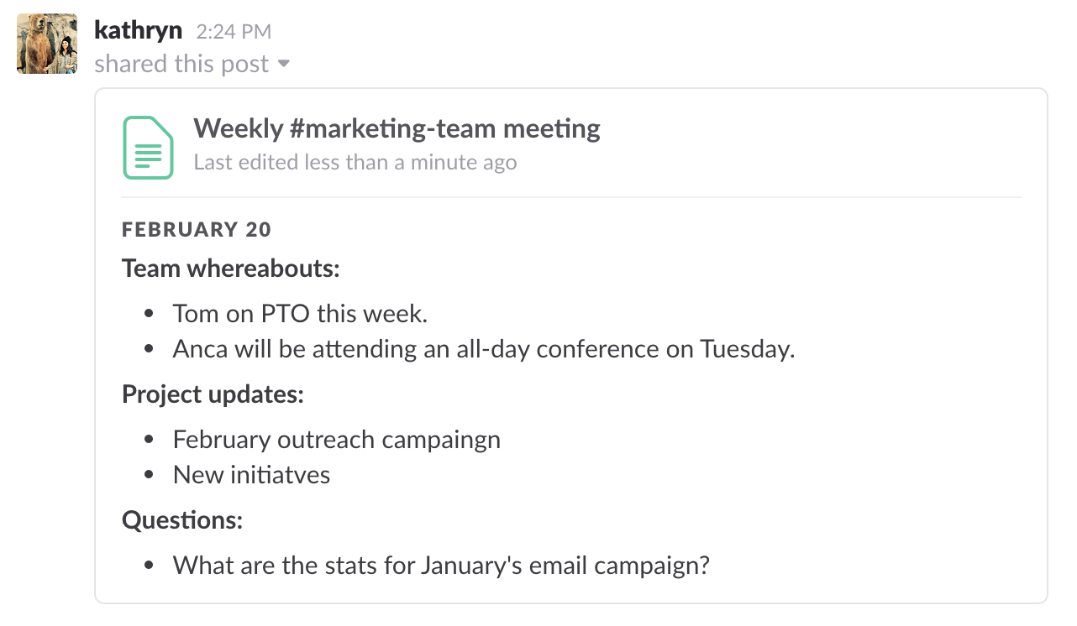
Our workspace
Communication + exchanging documents + sending GIFs == building our community

Slide 16
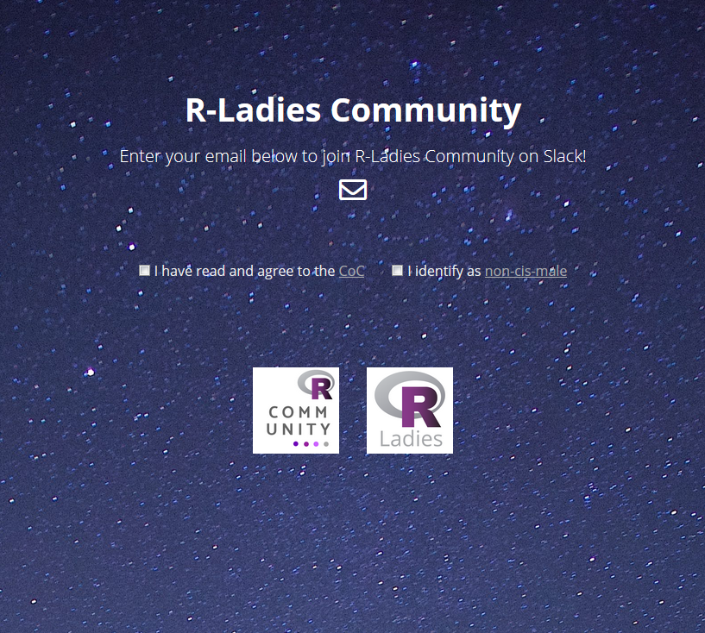
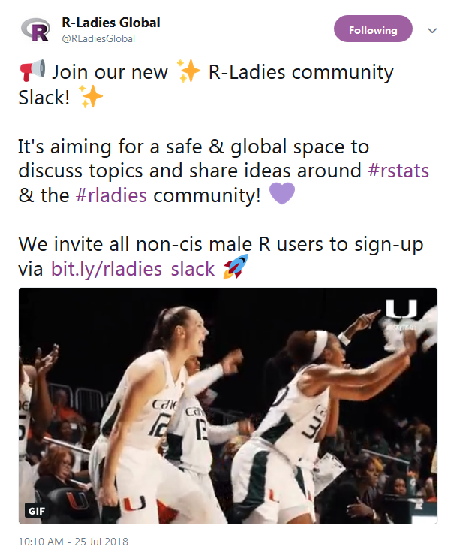
To join the R-Ladies slack, go to
rladies-community.slack.com
In case of doubts, drops us a line at
munich@rladies.org
and we’ll help you figure it out

Slide 17
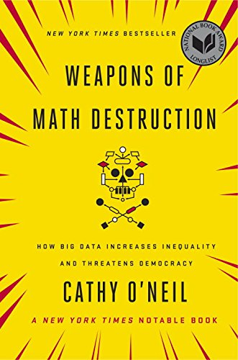


Book Club
Starting up next fall
Suggestions for titles, workflow, etc

Slide 18
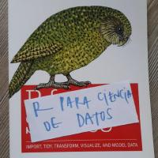
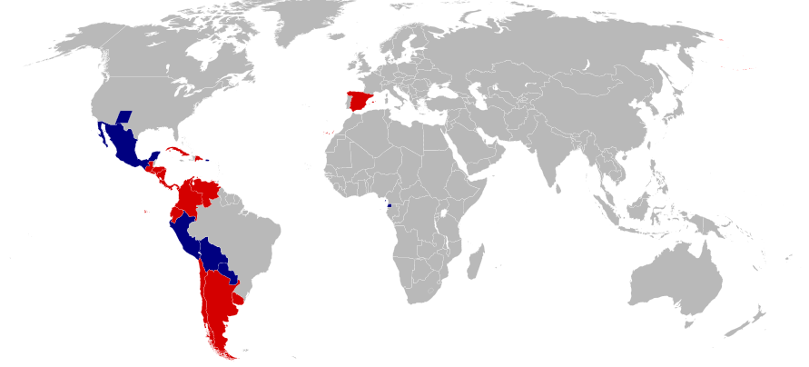
R4DS-es:
Translation of Hadley‘s classic into Spanish
By Ichwan Palongengi - Data based on Map-Hispano.png on Wikipedia Project, CC BY-SA 3.0, https://commons.wikimedia.org/w/index.php?curid=5332175
Call for translation reviewers open!
→ Contact Pam for more info

Slide 19

Data Journalism with R:
Experiences from the

Slide 20
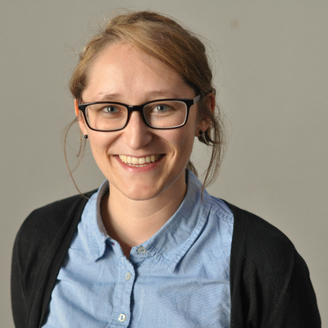

Katharina Brunner
info
Find her on

Slide 21
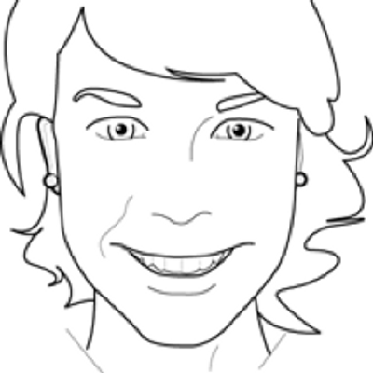
Martina Schories
dgdsb
You can also find her on

Slide 22
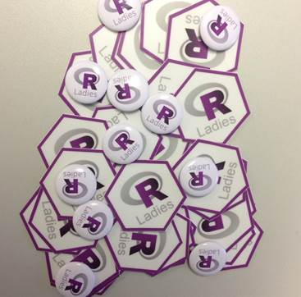
And now…
… it‘s time for some
refreshments & stickers

Slide 23
Bis zum nächsten Mal!
Next MeetUp
Date and topics to be announced, we will keep you updated

